Slide 1
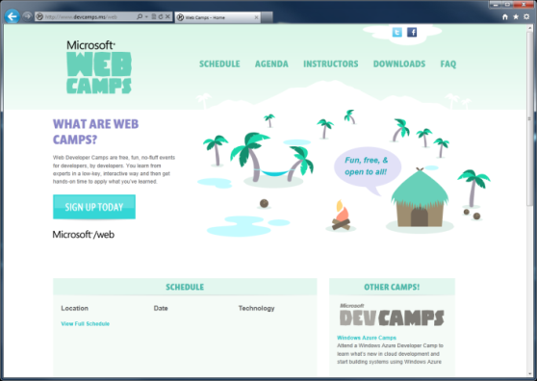

WebCamps Online
Twitter: Follow @webcamps Hashtag #webcamps
SPEAKER NAME/HANDLE HERE
Website: http://www.devcamps.ms/web
What are web camps?
Web Developer Camps are free, fun, no-fluff events for developers, by developers. You learn from experts in a low-key, interactive way and then get hands-on time to apply what you’ve learned.

Slide 2
Top 10 Things You Didn’t Know about WebMatrix 2
Name
Title
Microsoft Corporation

Slide 3
Agenda
WebMatrix 2 Gives You Options
Razor Syntax and ASP.NET Web Pages
Layouts
Helpers

Slide 4

WebMatrix Gives You Options
1
Start with a template
Pull in an existing app and start customizing
Open an existing site (even remotely)

Slide 5
Code Completion
2
Text Editing Improvements
WebMatrix adds code completion features for HTML 5, CSS 3, Razor syntax…
Even PHP!

Slide 6
Creating New Sites
demo
Using WebMatrix Templates

Slide 7
Razor

Slide 8

Where WebMatrix Fits into ASP.NET
HTML
XML
JSON
Web Forms
Razor View Engine
Code
Web Pages
MVC
MVC 4
Web API
ASP.NET Core
Self Host
Modules
Handlers
Membership
Where WebMatrix 2 Can Help
Intrinsics
Caching
Etc.
Notes:
Estimated Time: 2 minutes
No matter which type of developer you are, you get the benefit of the ASP.NET Core runtime, which provides many useful modules that provide functionality that you are likely to need when creating web applications. For example: Profile, Roles and Membership is important if you want to build in users and security around different parts of your website.
[Build x 3]
ASP.NET Web Forms, ASP.NET MVC and ASP.NET Web Pages are three different approaches to building web applications on the server side with ASP.NET. They all build on top of the same core runtime that provides them with the same powerful set of modules that web developers can leverage from within their web applications.
ASP.NET Web Forms is great for developers coming from desktop application development where they are accustomed to controls, event-driven development and code-behind. Despite not being concepts that are native to the web, Web Forms achieves this by abstracting away things like maintaining state, form posting and much more. This ease of development means that developers relinquish a certain amount of control as Web Forms manages communication between the server and client on your behalf.
ASP.NET MVC, in contrast, is for developers that like to be in full control of the interactions between client and server and provides a more “raw” approach to what happens in the web application. Due to its loosely coupled architecture, MVC is also very extensible with many places for developers to customize and plugin components as well write test code easily.
Developing in ASP.NET Web Pages is centered around inline code and is similar to PHP or classic ASP in that compilation of your application isn’t required (it is in WebForms and MVC). It is designed to provide the simplest approach to building websites with the fewest number of concepts to learn.
[Build x 2]
When it comes to controlling the markup that is rendered to the client there are two view engines you may use. The Web Forms view engine is shared by both Web Forms and MVC and uses the familiar <% %> syntax. With ASP.NET MVC 3 and ASP.NET Web Pages Microsoft introduced the Razor View Engine which uses a different syntax centered around the @ symbol. The Razor syntax uses fewer characters to achieve the same things in Web Forms and allows the developer to mix markup and code really easily.

Slide 9
Introducing Razor
3
The easiest way to code websites
Easy to mix HTML and Code
Lots of useful Helpers
Notes:
1 minute
When you create a new website from scratch in WebMatrix, you will be using the new Razor syntax.
It’s very compact and easy to read and write, and allows you to flow between code and markup seamlessly. You can write your code in languages such as C# or VB, and it’s extensible via Helpers (we’ll talk about Helpers in Part 3)

Slide 10
Razor Syntax Comparisons
Web Forms (6 markup transitions)
<ul>
<% for (int i = 0; i < 10; i++) { %>
<li><% =i %></li>
<% } %>
</ul>
PHP (2 markup transitions & an echo)
<ul>
<?php
for ($i = 0; $i < 10; $i++) {
echo("<li>$i</li>");
}
?>
</ul>
Razor (2 markup transitions)
<ul>
@for (int i = 0; i < 10; i++) {
<li>@i</li>
}
</ul>
Notes:
2 minutes
We’ve designed Razor to be concise and easy to use. When we think about the way developers use a language we take into account the context switching they have to do and also the number of keystrokes. The way that Razor allows you to transition seamlessly between markup and code makes for a much more natural and fluent style and also helps to reduce the number of keystrokes and context switching that a developer has to do, thinking about markup and code separately. With Razor, markup and code are really the same thing.
We think it’s the easiest way to code websites and when you compare it to the other languages out there, it’s easy to see why.

Slide 11
Move From Code to Markup Easily with Razor
Option 1:
HTML Block
@{
var name = “John Doe”;
<div>
Your name: @name
</div>
}
Option 2:
Text Block
@{
var name = “John Doe”;
<text>
Your name: @name
</text>
}
Option 3:
Single line of output in markup
@{
var name = “John Doe”;
@: Your name: @name
}
Notes:
1 minute
The transition from code to markup is one of the most elegant things about Razor but there a few rules that are worth knowing about.
Option 1:
Code is the primary citizen in a code block, not HTML. This means the parser will always expect code unless it finds valid opening (and closing) tags. In the first option block you see that after the @{ a name variable is defined. No additional tag is necessary.
A <div> section tells Razor that what follows should be taken as literal. Then the @name indicates a variable that needs to be replaced with its value.
Option 2:
Similarly, to explicitly call out text in a code block as HTML, wrap it in a <text> tag
Option 3:
Single line of output within markup can be denoted by @:
This option is useful when you don’t want to render an HTML element as part of the output.
Extra Knowledge (Advanced):
The Parser that understands Razor is itself a standalone assembly (System.Web.Razor.dll) which has no dependencies on ASP.NET which means you can use it to parse CSHTML/VBHTML files and produce C#/VB code in any .NET application.

Slide 12
Commenting in Razor
Option 1:
Markup
@*
<div>
Hello World
</div>
*@
Option 2:
Code
@{
//var name = "John Doe”;
//@name
}
Option 3:
Both
@*
@{
var name = "John Doe";
@name
}
*@
Notes:
1 minute
It’s always good practice to comment your code. In Razor we have the following options for commenting:
Option 1:
You can comment a block by using @* … *@
Please note that this method could not be recursive (you could not have a @* inside another @*)
Option 2:
You can comment lines by using // (in C#) the same way you do in your code files.
Option 3:
If you need to comment a whole razor block, you should add a @* before the beginning of the code block and a *@ after it’s finish.

Slide 13
Razor tools for a Consistent Look
Layouts
Consistent structure, organization (Includes ⇨ Master Pages ⇨ Layouts)
Sections
Named regions of dynamic code
<div id="grid">
@grid.GetHtml(
columns: grid.Columns(
grid.Column("Name", "Product", style: "product"),
grid.Column("Description", format:@<i>@item.Description</i>),
grid.Column("Price", format:@<text>$@item.Price</text>)
)
)
</div>
Pages
Include other pages that change infrequently into other pages
@{
var db = Database.Open("ArtGallery");
var data = db.Query("SELECT * FROM PRODUCTS);
var grid = new WebGrid(
source: data,
defaultSort: "Name",
rowsPerPage: 3);
}
Notes:
1 minute
Razor has some great tools to help you organize your markup, keep things consistent, and eliminate repetition.

Slide 14
Layout Syntax
Step 1:
Define your layout /Shared/_Layout.cshtml
<html>
<head>
<title>Simple Layout</title>
</head>
<body>
@RenderBody()
</body>
</html>
Step 2:
Reference the layout from your pages /Default.cshtml
@{
Layout = "/Shared/_Layout.cshtml";
}
<p>
My content goes here
</p>
Notes:
1 minute
The transition from code to markup is one of the most elegant things about Razor but there a few rules that are worth knowing about.
Option 1:
Code is the primary citizen in a code block, not HTML. This means the parser will always expect code unless it finds valid opening (and closing) tags. In the first option block you see that after the @{ a name variable is defined. No additional tag is necessary.
A <div> section tells Razor that what follows should be taken as literal. Then the @name indicates a variable that needs to be replaced with its value.
Option 2:
Similarly, to explicitly call out text in a code block as HTML, wrap it in a <text> tag
Option 3:
Single line of output within markup can be denoted by @:
This option is useful when you don’t want to render an HTML element as part of the output.
Extra Knowledge (Advanced):
The Parser that understands Razor is itself a standalone assembly (System.Web.Razor.dll) which has no dependencies on ASP.NET which means you can use it to parse CSHTML/VBHTML files and produce C#/VB code in any .NET application.

Slide 15
Use Sections to Organize Your Pages
Create the Section:
/Shared/_Layout.cshtml
<html>
<head>
<title>Simple Layout</title>
</head>
<body>
@RenderSection("Menu")
@RenderBody()
</body>
</html>
Embed the Section:
/MyPage.cshtml
@{
Layout = "/Shared/_Layout.cshtml";
}
@section Menu {
<ul id="pageMenu">
<li>Option 1</li>
<li>Option 2</li>
</ul>
}
<p>
My content goes here
</p>
Notes:
1 minute
The transition from code to markup is one of the most elegant things about Razor but there a few rules that are worth knowing about.
Option 1:
Code is the primary citizen in a code block, not HTML. This means the parser will always expect code unless it finds valid opening (and closing) tags. In the first option block you see that after the @{ a name variable is defined. No additional tag is necessary.
A <div> section tells Razor that what follows should be taken as literal. Then the @name indicates a variable that needs to be replaced with its value.
Option 2:
Similarly, to explicitly call out text in a code block as HTML, wrap it in a <text> tag
Option 3:
Single line of output within markup can be denoted by @:
This option is useful when you don’t want to render an HTML element as part of the output.
Extra Knowledge (Advanced):
The Parser that understands Razor is itself a standalone assembly (System.Web.Razor.dll) which has no dependencies on ASP.NET which means you can use it to parse CSHTML/VBHTML files and produce C#/VB code in any .NET application.

Slide 16
Use RenderPage to Include Static Content
Create the Page
/Shared/Footer.cshtml
<footer>
<div class=“copy">
© 2010 Contoso
</div>
</footer>
Include it in Another
/Shared/_Layout.cshtml
<html>
<head>
<title>Simple Layout</title>
</head>
<body>
@RenderSection("Menu")
@RenderBody()
@RenderPage("/Shared/_Footer.cshtml")
</body>
</html>
Notes:
1 minute
The transition from code to markup is one of the most elegant things about Razor but there a few rules that are worth knowing about.
Option 1:
Code is the primary citizen in a code block, not HTML. This means the parser will always expect code unless it finds valid opening (and closing) tags. In the first option block you see that after the @{ a name variable is defined. No additional tag is necessary.
A <div> section tells Razor that what follows should be taken as literal. Then the @name indicates a variable that needs to be replaced with its value.
Option 2:
Similarly, to explicitly call out text in a code block as HTML, wrap it in a <text> tag
Option 3:
Single line of output within markup can be denoted by @:
This option is useful when you don’t want to render an HTML element as part of the output.
Extra Knowledge (Advanced):
The Parser that understands Razor is itself a standalone assembly (System.Web.Razor.dll) which has no dependencies on ASP.NET which means you can use it to parse CSHTML/VBHTML files and produce C#/VB code in any .NET application.

Slide 17
Razor Syntax and Layouts
demo
Notes:
5 minutes
See demo script for flow

Slide 18
What About Data?
4
WebMatrix Database Editing
You can edit the schema of a site’s database or the data itself from within the IDE

Slide 19
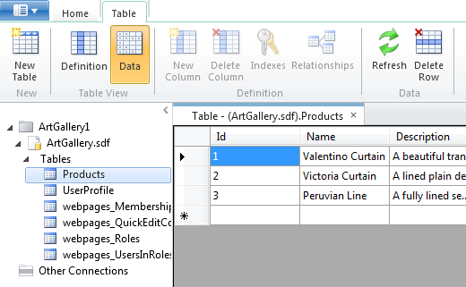
SQL Compact Edition Support
Design a Database Schema
Code Against the Database
@{
var db = Database.Open("ArtGallery");
var product = db.Query("SELECT * FROM PRODUCTS);
}
Designing
Notes:
2 minutes
The database that comes with WebMatrix is SQL Compact Edition, or SQL CE for short.
It’s free, lightweight and doesn’t require a separate server to run – which makes it much easier to get setup and running than traditional versions of SQL Server like SQL Server Express.
SQL Compact Edition includes tools to manage your tables and data and because it’s file-based, you simply need to copy the database files to transport your database to another machine. This is really useful if you are sharing a database with another developer.
This sample code shows how to connect to an ArtGallery Database and then perform a query with SQL to retrieve the ArtGallery products.

Slide 20
WebGrid Displays Your Data Easily
5
Displays your data quickly and easily
Lots of options to customize layout, appearance, paging etc.
@{
var db = Database.Open("ArtGallery");
var data = db.Query("SELECT * FROM PRODUCTS);
var grid = new WebGrid(data);
}
<div id="grid">
@grid.GetHtml();
</div>
<div id="grid">
@grid.GetHtml(
columns: grid.Columns(
grid.Column("Name", "Product", style: "product"),
grid.Column("Description", format:@<i>@item.Description</i>),
grid.Column("Price", format:@<text>$@item.Price</text>)
)
)
</div>
@{
var db = Database.Open("ArtGallery");
var data = db.Query("SELECT * FROM PRODUCTS);
var grid = new WebGrid(
source: data,
defaultSort: "Name",
rowsPerPage: 3);
}
Notes:
2 minutes
As we’ve seen, the database design and access from Razor code in WebMatrix is easy. Often when we’re building websites, we’ll want to render data in some form of table. The WebGrid can help to make this easy to do.
Build 1
In it’s simplest form, just give the WebGrid data and it will render it out in a valid HTML table. WebMatrix will make all the magic for you. But this has a few drawbacks: You’re not choosing the columns you want to show and they will be named as the field names in the database.
Build 2
In the second sample, you explicitly state which columns to include in the WebGrid, their title (e.g.: «Product» instead of «Name») and how they will be formatted: Product column will use a CSS style, Description will appear in italic font, and so on.
Build 3
In the last sample, you can see that we order the data by the «Name» column and by simply defining one parameter, we state that we want 3 rows per page. WebMatrix will do the rest for you.

Slide 21
Database Access
demo
Notes:
5 minutes
Creating DB
Designing DB
Accessing DB using Razor
(introduce URLData)

Slide 22
Helpers
6
Quickly add common functionality into your sites
HTML Helpers
Make is faster and easier to render commonly used markup to the page.
Examples: Facebook, Twitter
API Helpers
Make is faster and easier to call complex APIs from your website.
Examples: PayPal, OData, Windows Azure Storage
Notes:
2 minutes
WebMatrix Helpers help you add common functionality to your Web site. They can be used to solve a specific web site tasks. You can think of them as bricks that are used/reused and interconnected to build a site. Nothing stops you from creating a helper and reusing it on different pages of your site, or even in different sites. And you can use helpers created by others. Here is a sample of existing

Slide 23
Adding Helpers to Your Website
There are two ways to install Helpers in your website
1
2
Package Manager
Manual download
Notes:
1 minute
Although these three ways to install Helpers are simple and straightforward, we’ll focus on the first one: using the Package Manager, but you could manually download and copy a Helper to your site folder. Either will work for you.

Slide 24

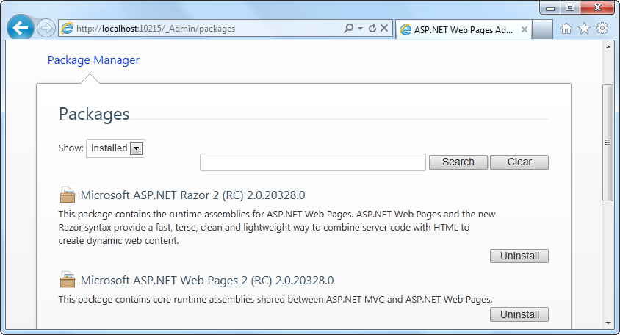
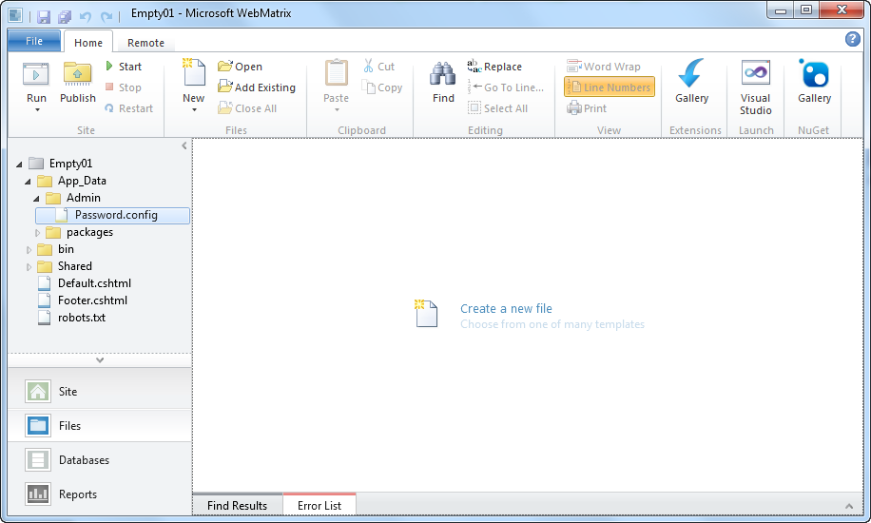
NuGet Integration
7
Site Administration at /_Admin
The Gallery Toolbar
Notes:
1 minute
To install Helpers using the Package Manager, you have to browse _admin page of your site. If it’s the first time, you’ll be prompted to enter a new password, that will be used for further visits.
After that, a page will display a list of Helpers, indicating which are already installed and which could be installed.
We will show you this process in a demonstration shortly…

Slide 25

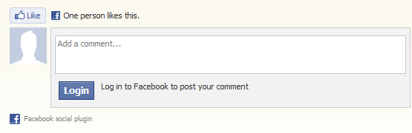




Make Your Website Social
Add social capabilities to your website with the WebMatrix Helper for Facebook
There are many more helpers available for WebMatrix
@FacebookSocialPlugins.Comments()
Notes:
1 minute
If people like something on your site, they often want to share it with friends. For instance, to comment on Facebook, you can download the FacebookSocialHelper and then add the @FacebookSocialPlugins.Comments() in your page to show the Facebook comments’ controls.
Microsoft has also been working on a large number of helpers for WebMatrix including Twitter, PayPal, bit.ly and Uservoice. They are all available using Package Manager and they are designed to be very easy to use.

Slide 26
Helpers
demo
Notes:
5 minutes
For detailed steps please see the demo scripts
// more this to the demo script
New Bakery (existing bakery from prev demo?)
Install Twitter to the homepage
Add Twitter to the homepage
Install Facebook Social Plugin
Show how we have other helpers like PayPal

Slide 27
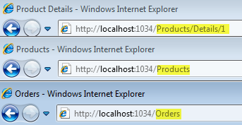
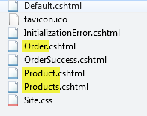
Routing
8
WebMatrix automatically provides “clean” URLs using Routing and removes the need to use QueryStrings
Routing has the following benefits:
Easier to read for your users
Better for SEO
Notes:
2 minutes
Today’s websites often use “clean URLs” that make the current page much more readable for both humans and search engines. With WebMatrix you get the modern, clean urls out of the box because it uses “routing” by default.
Routing maps a URL to a resource on the server using a set of predetermined rules. For instance a url with Order will map to Order.cshtml. If you add a “slash” and a string after the first route segment, like in the “product” example, that string will become part of the “Url Data” which is then accessible in code from within product.cshml.

Slide 28
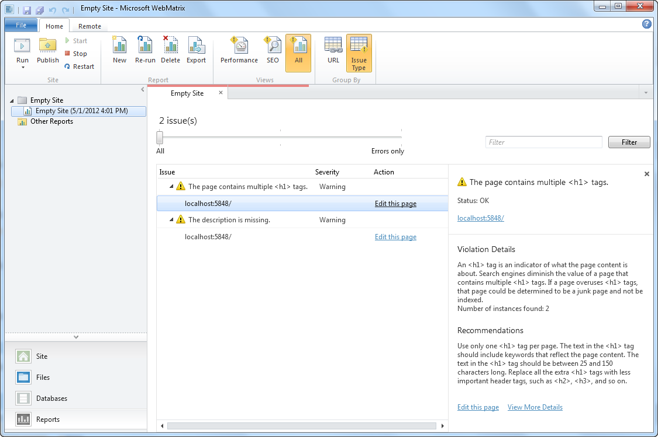
WebMatrix Reports
9
Suggestions to improve your site and SEO quality

Slide 29
Routing & Reports
demo
Notes:
5 minutes
For detailed steps please see the demo scripts
// more this to the demo script
New Bakery (existing bakery from prev demo?)
Install Twitter to the homepage
Add Twitter to the homepage
Install Facebook Social Plugin
Show how we have other helpers like PayPal

Slide 30
What is Membership?
10
Provides registration for users
Organize users into roles
Restrict access to pages on your website based on user or role
WebMatrix includes helpers & database that makes setting up membership easy
Some templates include Admin folder with all the pages required for membership
Notes:
1 minute
You can set up your website so that users can log into—that will mean that your site should support membership. This can be useful for many reasons. For example, your site might have features that are available only to members. In some cases, you might require users to log in to send you feedback or leave a comment.
Even if your website supports membership, users aren't necessarily required to log in before they use some of the pages on the site. Users who aren't logged in are known as anonymous users.
A user can sign in on your website and can then log in to the site. The website requires a user name (or an email address) and a password to confirm that users are who they claim to be. This process of logging in and confirming a user’s identity is known as authentication.

Slide 31
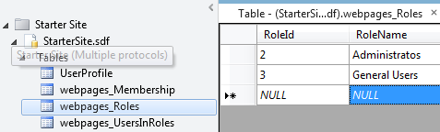
Setting Up Membership
Setup membership in one line of code
/_AppStart.cshtml
@{
WebSecurity.InitializeDatabaseConnection("StarterSite", "UserProfile", "UserId", "Email", true);
}
StarterSite database
Notes:
1 minute
The StarterSite Template comes with membership configured, and with a Database ready to be filled with users as well as their roles in the website.
First, you have to uncomment the WebSecurity.InitializeDatabaseConnection and fill the parameters with a userProfile and userId to be defined in the database.

Slide 32
Controlling Access to Pages
You can control access to pages based on the following:
Is the user logged in?
Does the user have access to the page?
Does the user belong to the correct role?
@if (!WebSecurity.IsAuthenticated) {
Response.Redirect("/Account/Login");
}
@if ( Roles.IsUserInRole("admin")) {
<span> Welcome <b>@WebSecurity.CurrentUserName</b>! </span>
}
Notes:
1 minute
By using Membership you can easily verify if the user is authenticated, or if it’s an anonymous user. Also if the user trying to reach a specific page has a role with granted privileges to that page.

Slide 33
Membership
demo
Notes:
5 minutes
For detailed steps please see the demo scripts
// more this to the demo script
New Bakery (existing bakery from prev demo?)
Install Twitter to the homepage
Add Twitter to the homepage
Install Facebook Social Plugin
Show how we have other helpers like PayPal

Slide 34
Why Build Helpers?
11
(Bonus!)
1
2
Helpers make you more productive
Helpers make it easier for other developers to use your widgets or services
Create Helpers for code that is repetitive
Create Helpers for code that is complex
Useful if you are trying to create a developer ecosystem of your own
Notes:
1 minute
There are a couple of reasons why you might want to build your own helpers for WebMatrix.
Firstly, over time you will find that using Helpers will save you time when building websites with WebMatrix. There will also be times when you find yourself doing repetitive and/or complex tasks. This is often a sign that a Helper will help you to save time in future projects with code-reuse.
Secondly, Helpers are useful when trying to create a developer ecosystem around your own product/website/service by making it as simple as possible to get going building a website that uses your stuff.

Slide 35
Build a Helper: The 3 Approaches
Use Inline Code
Use a Class (Intermediate)
Use an assembly (DLL) (Advanced)
@helper syntax using CSHTML
For simple helpers
Static class with Static methods
For helpers that use .NET Framework
Requires Visual Studio 2010 for development
For complex helpers that require testing
Notes:
3 minutes
There are 3 approaches for building WebMatrix Helpers.
Using Inline Code
This is the simplest approach for building helpers.
An Inline Code helper uses Razor, and its cshtml code file is stored inside App_Code.
When should we use it? For simple helpers
Using a Static Class
This approach is an enhancement of Inline codes helpers, that uses Csharp or Vbasic classes.
When should we use it? For more helpers that use .NET Framework
Creating an assembly (DLL)
This is an advanced approach for Visual Studio developers.
When should we use it? For complex helpers that will require more than one code file, and will also require testing.
In the next slides, we will explore the first 2 approaches…

Slide 36
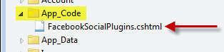
Building Helpers – Inline Syntax
@helper Easy to create HTML shortcuts
Wrap commonly used HTML
@helper HelloWorld(string name = "") {
<div>Hello @name</div>
}
@functions Return values from your helpers
Good for wrapping complex APIs
@functions {
public static string SayHello(string name) {
return “Hello ” + name;
}
}
App_Code Folder The name of the file is important It is used as the class name
@FacebookSocialPlugins.ShowLoginButton(...);
Notes:
2 minutes
We’ve designed Razor to be concise and easy to use. When we think about the way developers use a language we take into account the context switching they have to do and also the number of keystrokes. The way that Razor allows you to transition seamlessly between markup and code makes for a much more natural and fluent style and also helps to reduce the number of keystrokes and context switching that a developer has to do, thinking about markup and code separately. With Razor, markup and code are really the same thing.
We think it’s the easiest way to code websites and when you compare it to the other languages out there, it’s easy to see why.

Slide 37
Building Helpers
demo
Notes:
5 minutes
See demo script for flow

Slide 38
Recap: Top 10 11 Things You Just Learned about WebMatrix 2
WebMatrix gives you options
Code Completion
Introducing Razor
Database Design and Access
WebGrid
Built-in helpers
NuGet Integration
Routing
Reporting
Membership
Built your own helpers

Slide 39
Get This Content, and More
www.webcamps.ms
www.asp.net/webmatrix
www.microsoft.com/web/webmatrix

